Slide 1
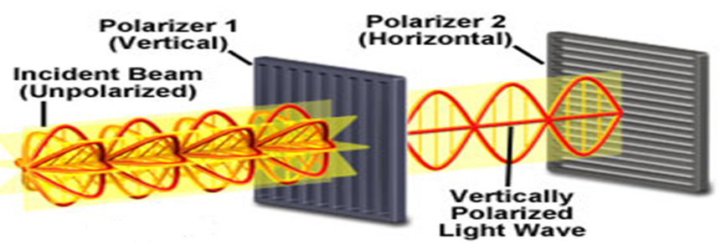
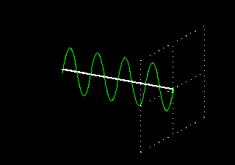
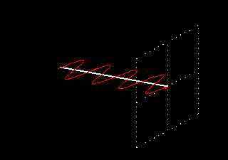

Slide 2
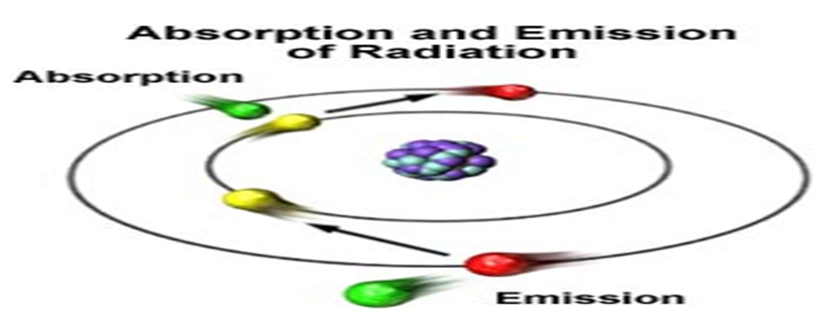
ΔE = μwave photon
ΔE = IR photon
E
N
E
R
G
Y
ΔE = UV/Vis photon

Slide 3
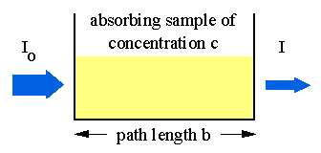
o
A = abc
hν
hν̅
A = εbc
g

Slide 4
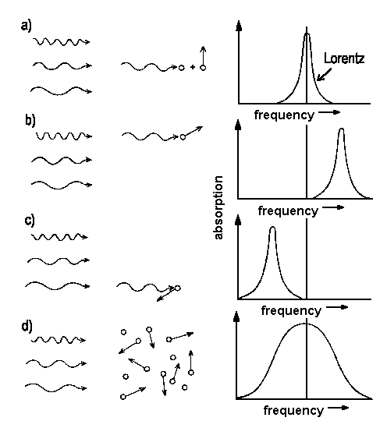
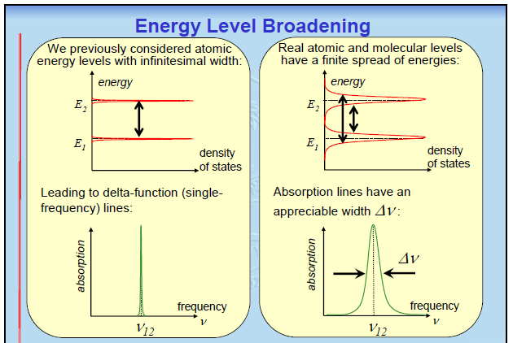
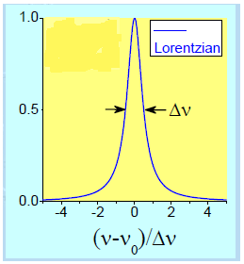

Slide 5
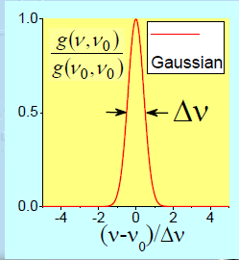
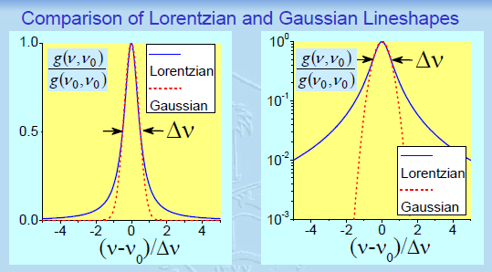

Slide 6
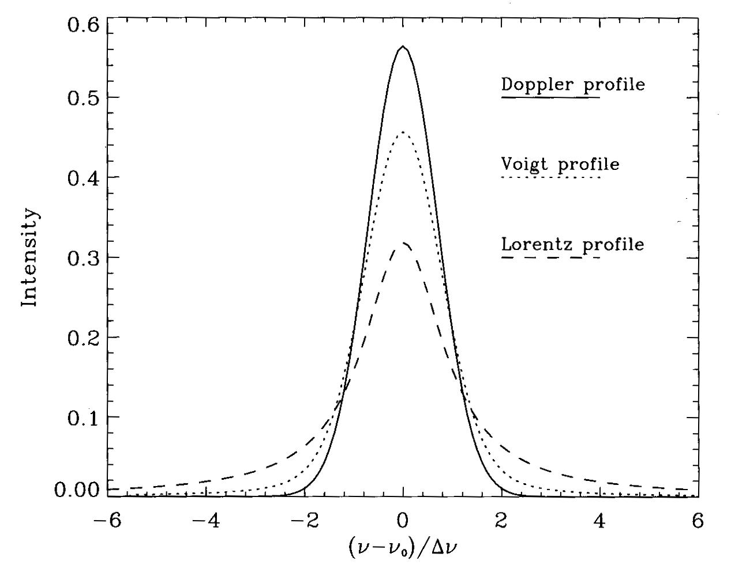
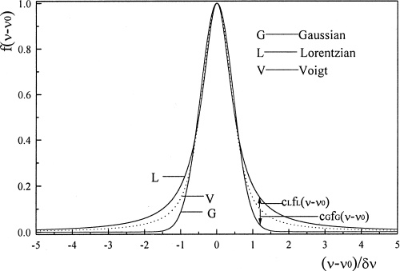
Doppler shift can be used to tell us how fast an object is rotating. How?
You hear a thunder clap 6 s after you see the lightning. Assume the speed of sound to be 343 m/s. How far away is the lightning?

Slide 7
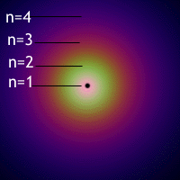
Photon Emission
Spontaneous
Stimulated
I_{e} = N_{o} A_{og} + N_{o} B_{og} ρ hν
3
Absorption
2
I_{a} = ρ (N_{g} – N_{o}) B_{go} hν
1

